Slide 1
PHYS4260 Quantum Mechanics II Spring 2025
Time-Independent Perturbation Theory

Slide 2
Outline
Higher order degeneracy
The Fine Structure of Hydrogen
Relativistic corrections
Spin-Orbit Interaction

Slide 3
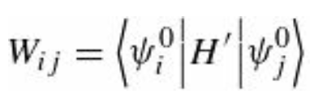
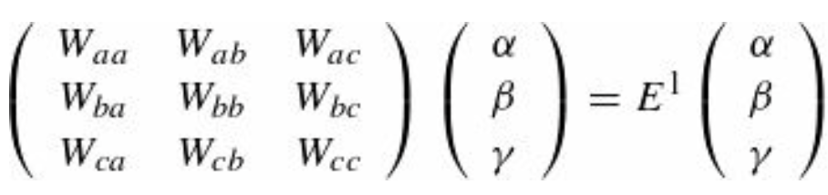
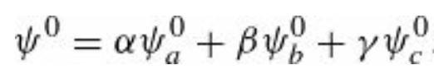
Higher-Order Degeneracy
So far, we assumed the degeneracy was two-fold, but it is easy to see how the method generalizes. In the case of n-fold degeneracy, we look for the eigenvalues of the n x n matrix
For three-fold degeneracy (with degenerate states $ψ_{a}$ , $ψ_{b}$ and $ψ_{c}$) the first-order corrections to the energies $E^{1}$ are the
eigenvalues of $W$ determined by solving
and the “good” states are the corresponding eigenvectors

Slide 4
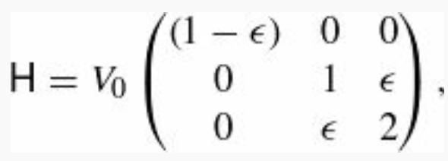
Higher-Order Degeneracy: Example
Consider a quantum system with just three linearly independent states. Suppose the Hamiltonian, in matrix form, is
where $V_{0}$ is a constant and $ε$ is a small parameter ($ε≪1$).
Write down the eigenvectors and eigenvalues of the unperturbed Hamiltonian ($ε=0$).
Solve for the exact eigenvalues of $H$. Expand each of them as a power series in $ε,$ up to second order.
Use first- and second-order non-degenerate perturbation theory to find the approximate eigenvalue for the state that grows out of the nondegenerate eigenvector of $H^{0}$. Compare the exact result, from (B).
Use degenerate perturbation theory to find the first-order correction to the two initially degenerate eigenvalues. Compare the exact results.

Slide 5
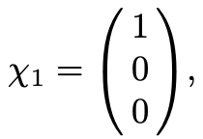
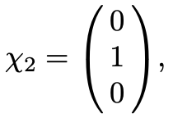
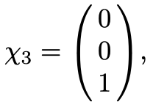
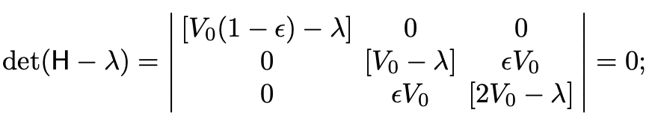
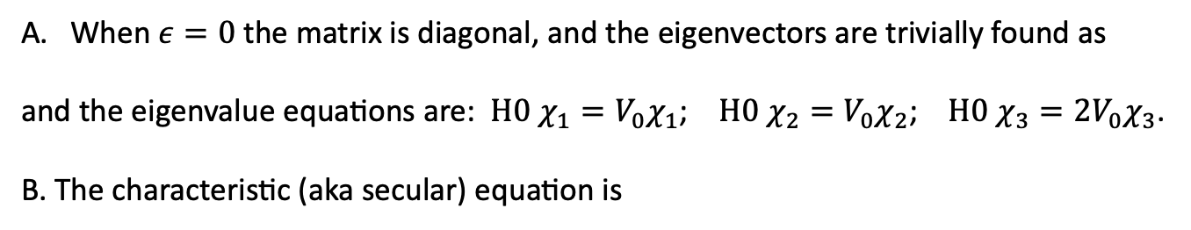
Higher-Order Degeneracy: Example
When $ε=0$ the matrix is diagonal, and the eigenvectors are trivially found as
and the eigenvalue equations are: $H0 χ_{1}=V_{0}χ_{1}$; $H0 χ_{2}=V_{0}χ_{2}$; $H0 χ_{3}={2V}_{0}χ_{3}$.
B. The characteristic (aka secular) equation is
and one obtains
First root
The other two roots are

Slide 6
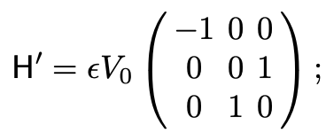
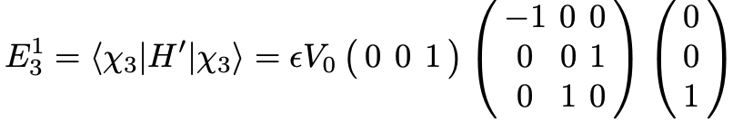
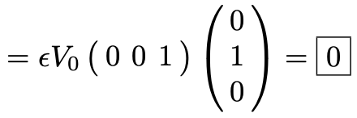
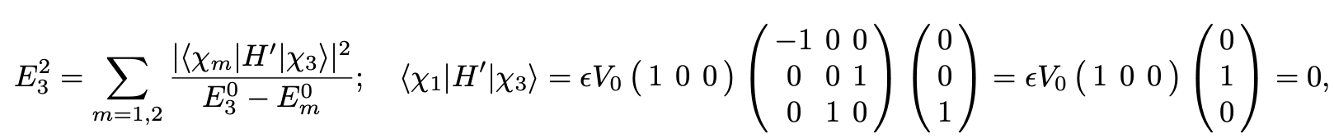
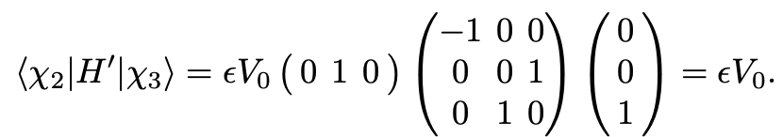
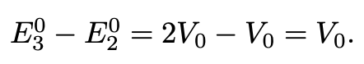
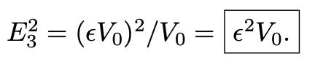
Higher-Order Degeneracy: Example
C. The perturbation to the Hamiltonian can be written as
The state that grows out of the nondegenerate eigenvector of $H^{0}$ is $χ_{3}$. Therefore, the 1st order correction to the energy is
No 1st order correction
The 2nd order correction is obtained as
Through second-order, then,
(same as we got for λ3 in part (B))

Slide 7
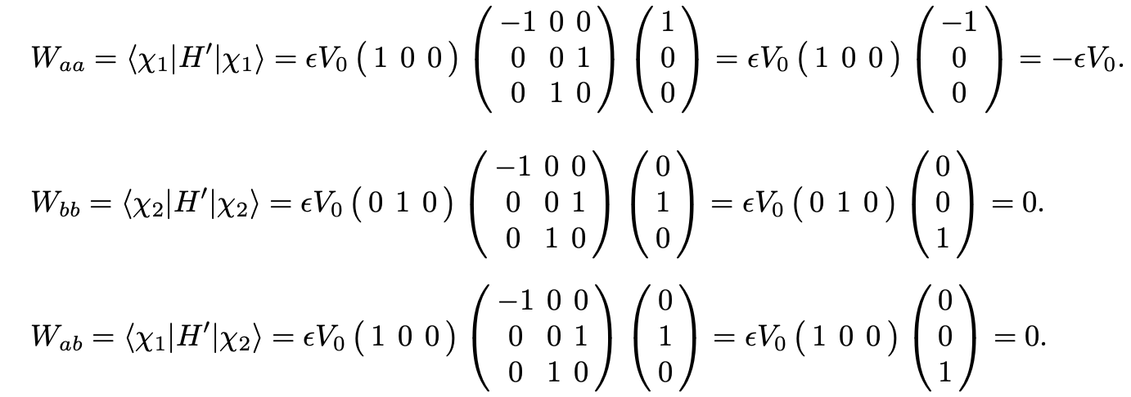
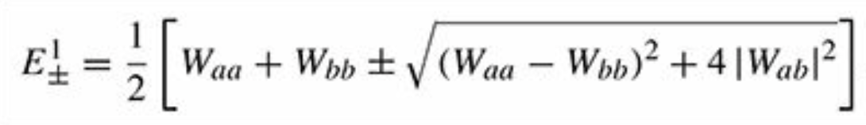
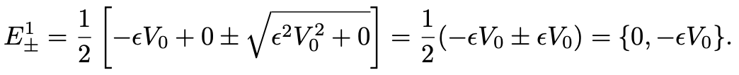
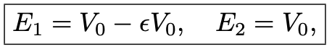
Higher-Order Degeneracy: Example
D. Using degenerate perturbation theory to find the first-order correction to the two initially degenerate eigenvalues,
we obtain
To first-order, then,
and these are consistent (to first order in ε) with what we got in (B).

Slide 8
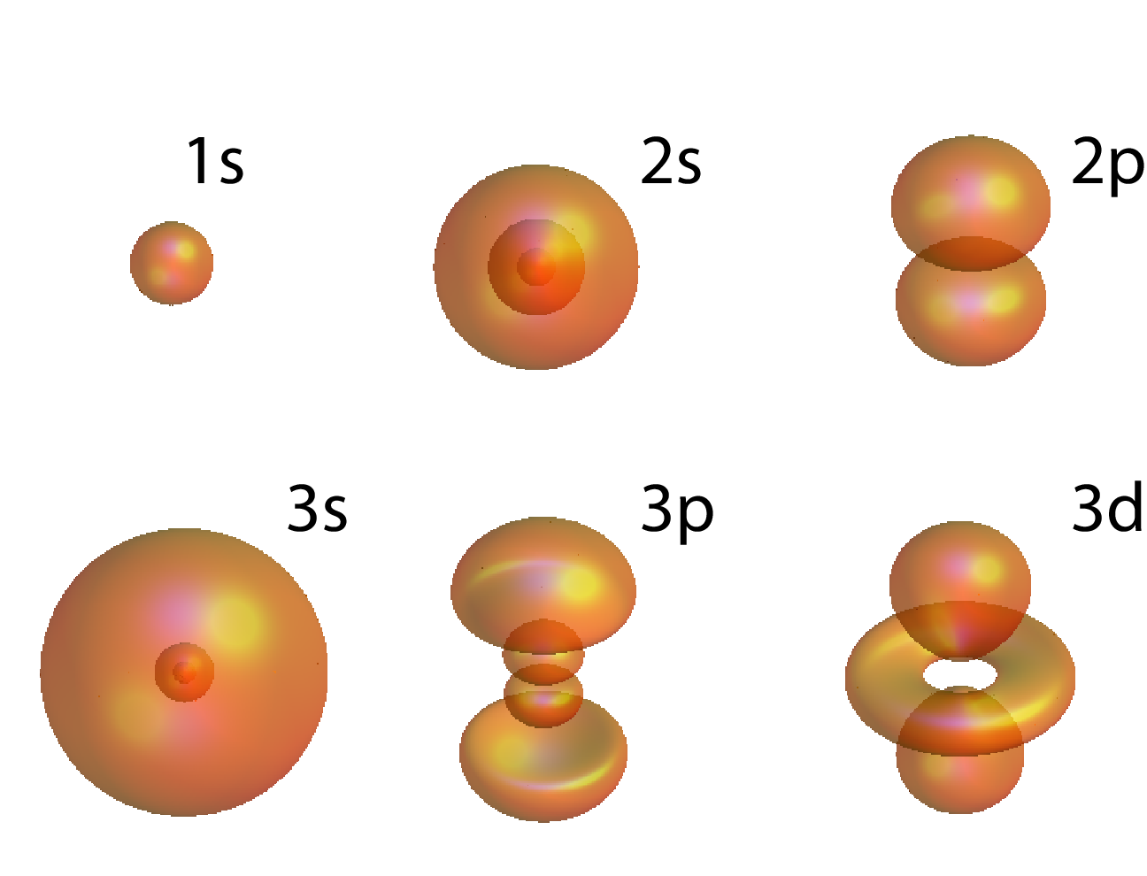
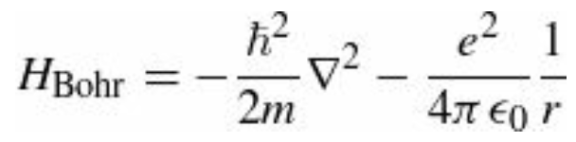
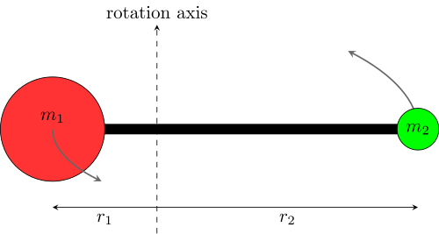
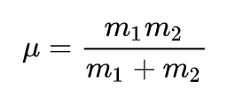
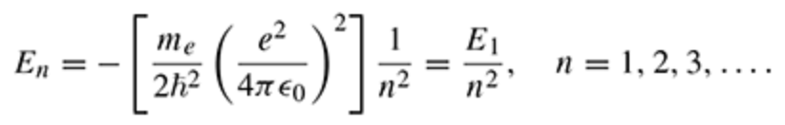
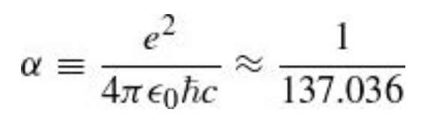
The Fine Structure of Hydrogen
In our previous studies of the hydrogen atom, we used the Bohr Hamiltonian
This accounts for the electron kinetic energy plus Coulombic potential energy.
Not the whole story!
We need to correct for the motion of the nucleus: replace m by the reduced mass.
More significant is the so-called fine structure, which is due to two distinct mechanisms:
relativistic correction, and spin-orbit coupling.
Compared to the Bohr energies,
fine structure is a tiny perturbation—smaller by a factor of

Slide 9
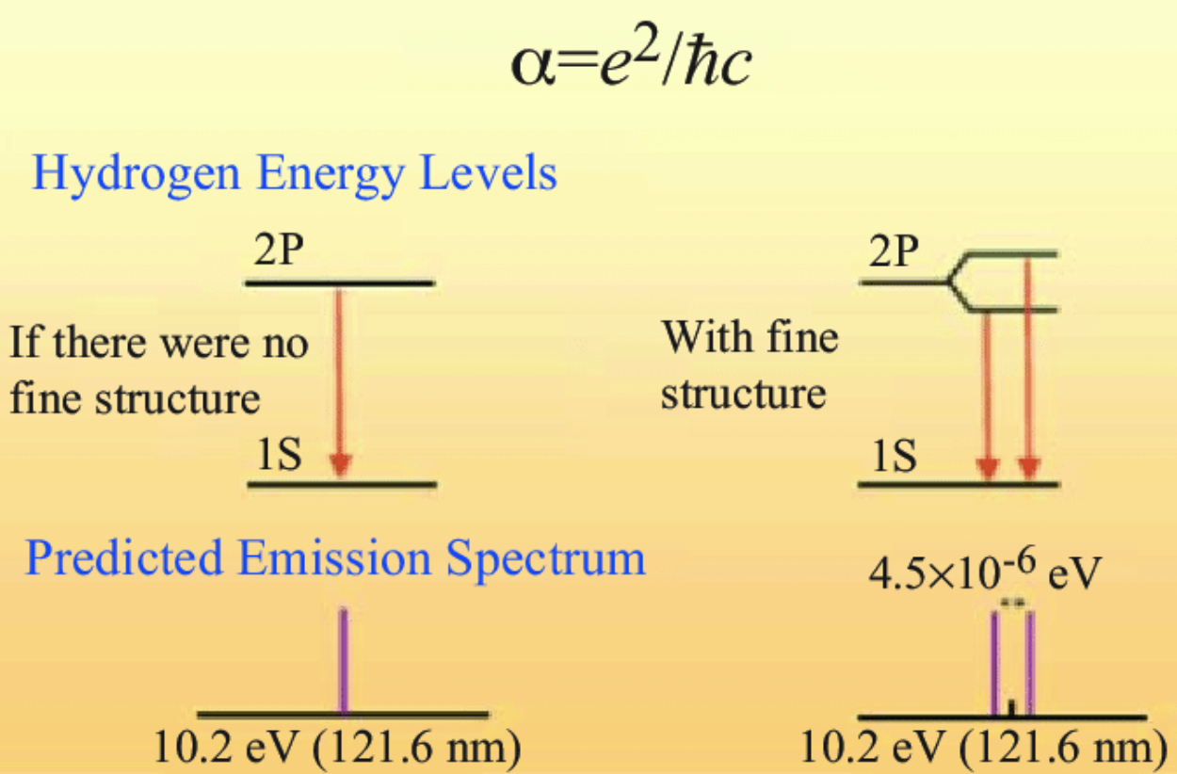
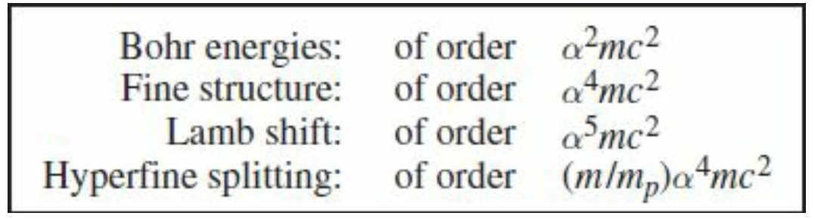
The Fine Structure of Hydrogen
fine structure constant
Smaller still by another factor of $α$ is the Lamb shift, associated with the quantization of the electric field.
Smaller by yet another order of magnitude is the hyperfine structure, which is due to the interaction between the magnetic dipole moments of the electron and the proton.
This hierarchy is summarized in the Table below.
We will analyze the fine structure of hydrogen, as an application of time-independent perturbation theory.

Slide 10
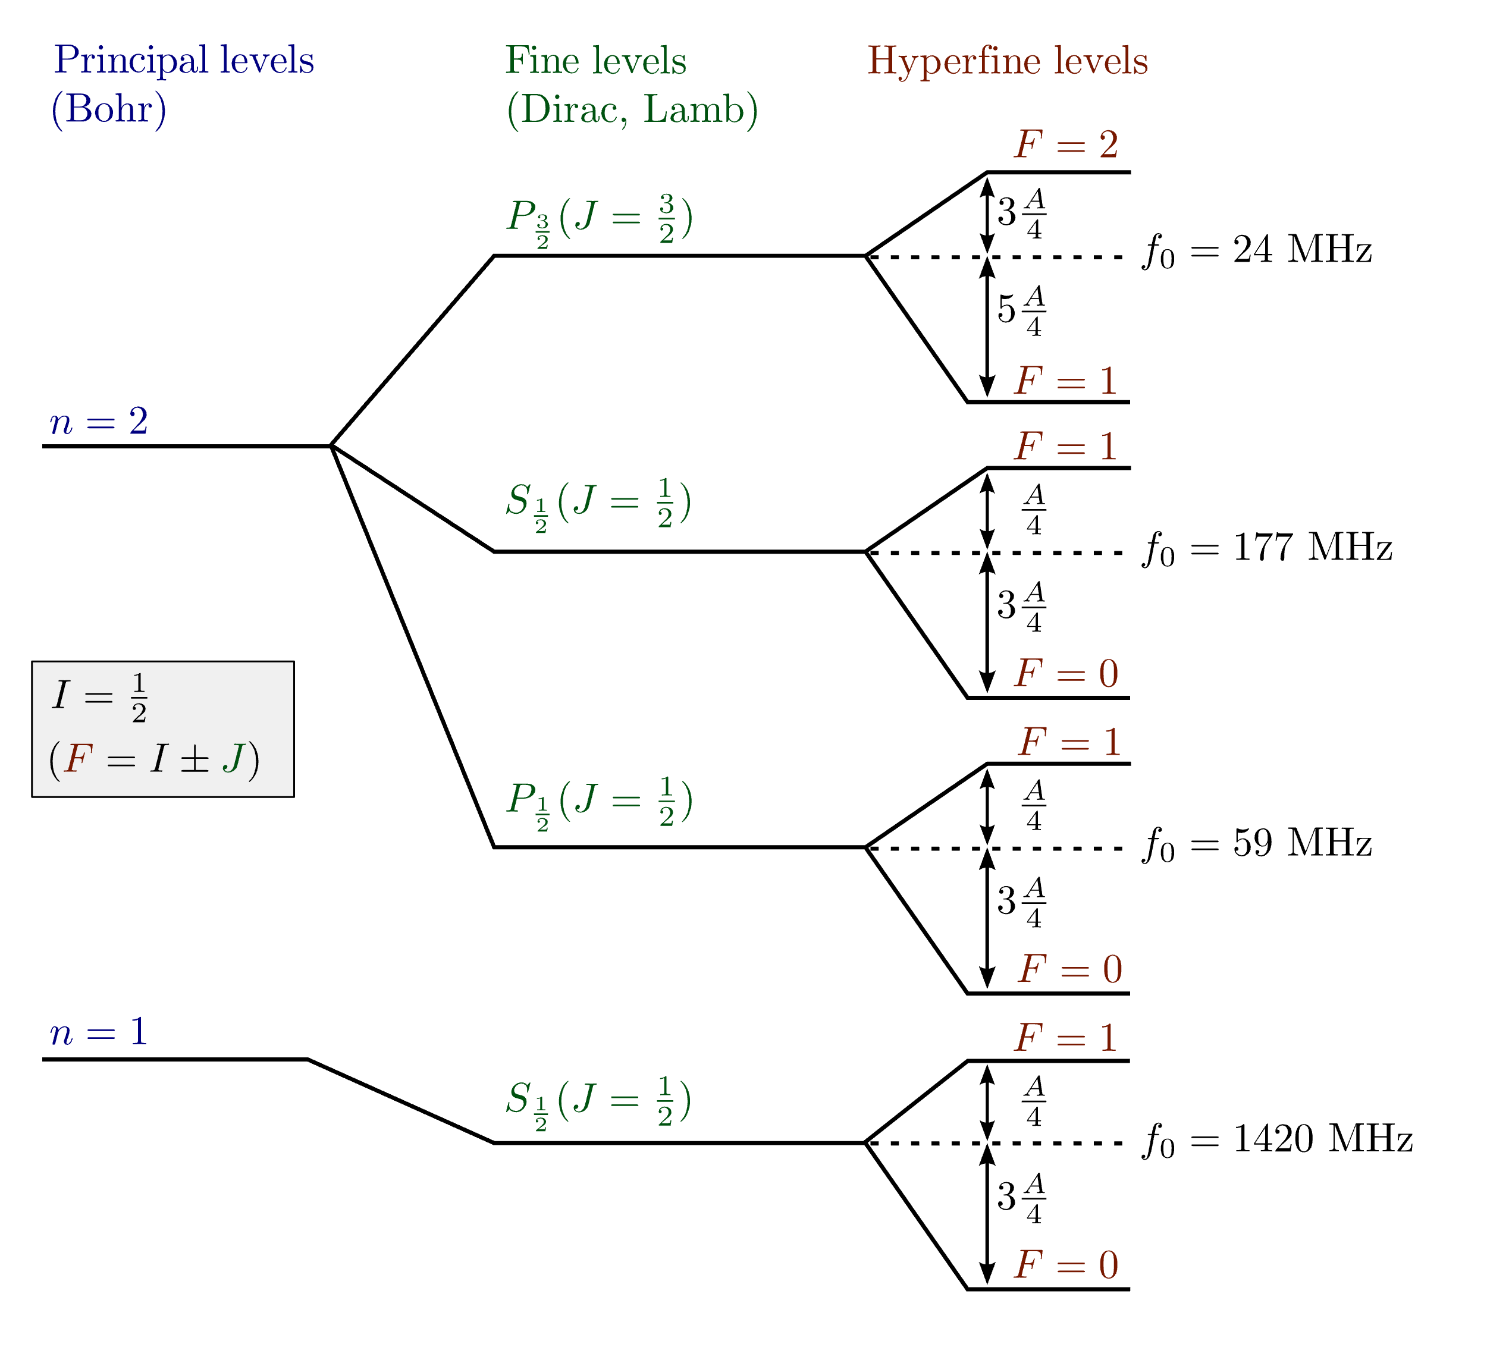
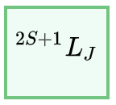
The Fine Structure of Hydrogen
Spectroscopic notation
$S$ = total spin quantum number for the atom's electrons. The value $2S + 1$written in the term symbol is the spin multiplicity, which is the number of possible values of the spin magnetic quantum number $m_{s}$ for a given spin $S$.
$J$ = total angular momentum quantum number for the atom's electrons. $J$ has a value in the range from $|L − S|$ to $L + S$.
$L$ = total orbital quantum number in spectroscopic notation, in which the symbols for $L$ are

Slide 11
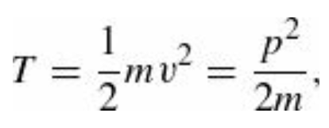
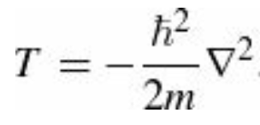
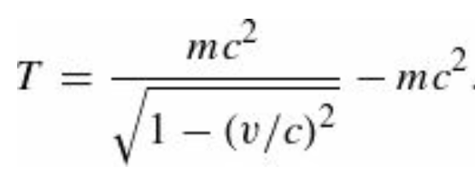
The Relativistic Correction
The first term in the Hamiltonian is supposed to represent kinetic energy:
But this is the kinetic energy definition in classical mechanics. The relativistic expression is given observing that
The first term is the total relativistic energy (not counting potential energy, which we aren’t concerned with at the moment), and the second term is the rest energy—the difference is the energy attributable to motion.

Slide 12
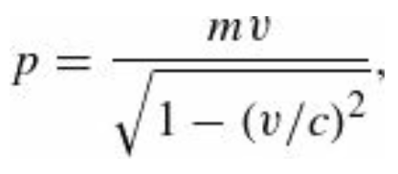
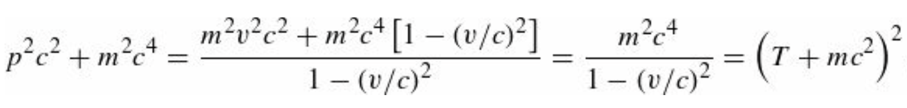
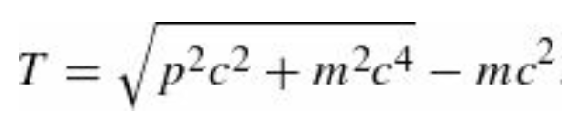
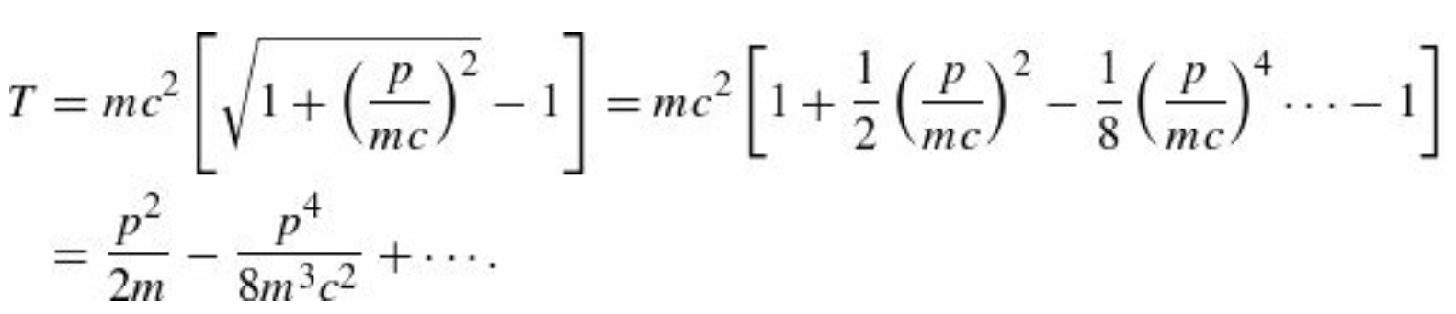
The Relativistic Correction
We need to express $T$ in terms of the (relativistic) momentum instead of velocity.
Notice that
Which immediately gives
This relativistic equation for kinetic energy reduces (of course) to the classical result, in the nonrelativistic limit $p≪mc$.
Expanding in powers of $p/(mc)$

Slide 13
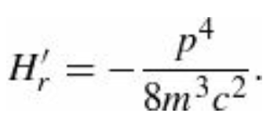
The Relativistic Correction
The lowest-order relativistic correction to the Hamiltonian is therefore
Observation 1: The kinetic energy of the electron in hydrogen is of the order of 10 eV, which is minuscule compared to its rest energy (0.511 MeV), so the hydrogen atom is basically nonrelativistic, and we can afford to keep only the lowest-order correction.
Observation 2: In this equation p is the relativistic momentum, not the classical momentum mv. It is the former that we now associate with the quantum operator

Slide 14
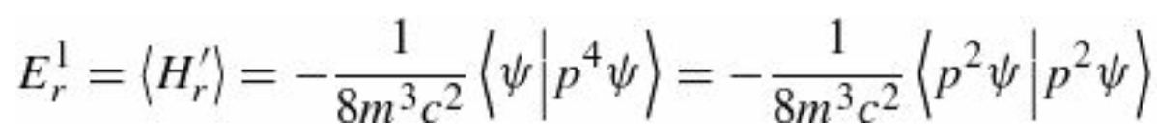
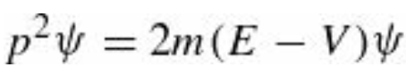
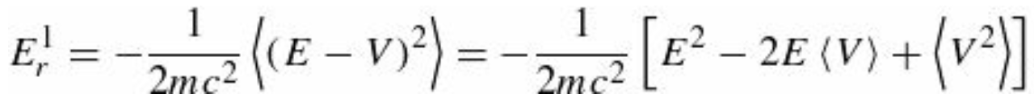
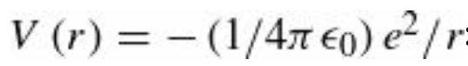
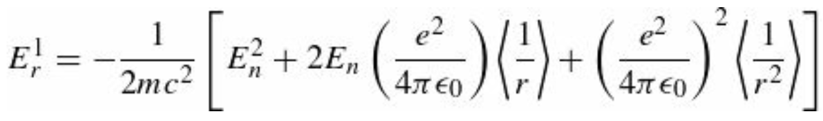
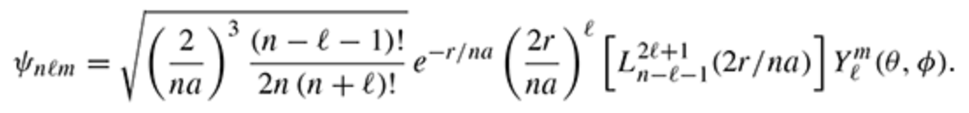
The Relativistic Correction
At this point, it is not difficult to guess that the perturbation term $H’$ in this case is $H_{r}^{′}$. In first-order perturbation theory, the correction to $E_{n}$ is given by the expectation value of $H_{r}^{′}$ in the unperturbed state:
Now, the Schrödinger equation (for the unperturbed states) says hence
This expression is completely general. We need to specialize it to the hydrogen atom case:
where $E_{n}$ is the Bohr energy of the state in question. To complete the job, we need the expectation values of $1/r$and ${1/r}^{2}$
in the (unperturbed) state $ψ_{nlm}$

Slide 15
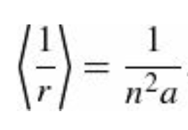
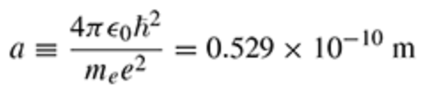
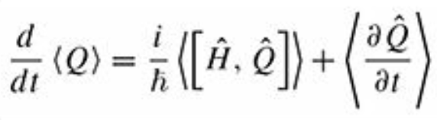
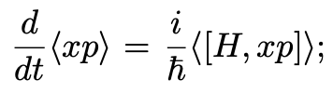
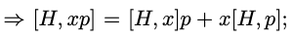
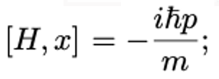





The Relativistic Correction: the $\left\langle 1/r\right\rangle$ term
The expectation value of $1/r$ is given by
where a is the Bohr radius
To obtain this results, we use the generalized Ehrenfest theorem (aka virial theorem)
We apply it to $\left\langle Q\right\rangle =\left\langle r∙p\right\rangle$. We start in 1dim, with $\left\langle Q\right\rangle =\left\langle xp\right\rangle$
and we compute
and
In 3dim one obtains
and

Slide 16









The Relativistic Correction: the $\left\langle 1/r\right\rangle$ term
Therefore
and one obtains
For stationary states,
If we consider the case of the hydrogen atom:
Therefore, . But
where

Slide 17





The Relativistic Correction: the $\left\langle 1/r^{2}\right\rangle$ term
The calculation of $\left\langle 1/r^{2}\right\rangle$ requires more sophistication. We start recalling that the radial TISE equation is
from which one deduces that for hydrogen, the radial Hamiltonian is
= reduced mass
This expression depends on the quantum number $l.$ Promoting $l$to be a continuous parameter allows for the derivative
of the Hamiltonian to be taken:
At this point we use the Hellmann-Feynman theorem(*):
* We’ll prove the theorem at the end of this discussion.

Slide 18








The Relativistic Correction: the $\left\langle 1/r^{2}\right\rangle$ term
$$n=N+l$$
According to Hellmann-Feynman
This proves that
From this, it follows that
where we just reinstated the mass of the electron instead of the reduced mass. Using the Bohr’s radius definition

Slide 19

The Relativistic Correction: the $\left\langle 1/r^{2}\right\rangle$ term
Evidently the relativistic correction is smaller than $E_{n}$ by a factor of about
It is important to noticed that we used non-degenerate perturbation theory in this calculation in spite of the fact that the hydrogen atom is highly degenerate. But the perturbation is spherically symmetric, so it commutes with $L^{2}$and $L_{z}$.
Moreover, the eigenfunctions of these operators (taken together) have distinct eigenvalues for the $n^{2}$ states with a given $E_{n}$. Luckily, then, the wave functions $ψ_{nlm}$ are the “good” states for this problem (or, as we say $n, l, m$are good quantum numbers) so as it happens the use of nondegenerate perturbation theory was legitimate.
From our equations we see that some of the degeneracy of the n-th energy level has lifted. But the $2l+1$ fold degeneracy in m remains. This is due to rotational symmetry, a symmetry that remains intact with this perturbation. On the other hand, the “accidental” degeneracy in $l$ has disappeared; since its source is an additional symmetry unique to the $1/r$ potential, we expect that degeneracy to be broken by practically any perturbation.

